Slide 1

Working with modern technology

Slide 2
Getting Started with Microsoft 365

Slide 3

Courtney Hodge
Program Manager of Inclusive Learning

Slide 4





In this course
Word
Excel
OneNote
Outlook
PowerPoint

Slide 5
Introduction to Microsoft 365

Slide 6
Using Templates

Slide 7
In this lesson:
Applying Word templates

Slide 8

Update Your Resume
Apply a new template
Review the new format

Slide 9
Applying Styles

Slide 10
In this lesson:
Modifying documents with Styles

Slide 11
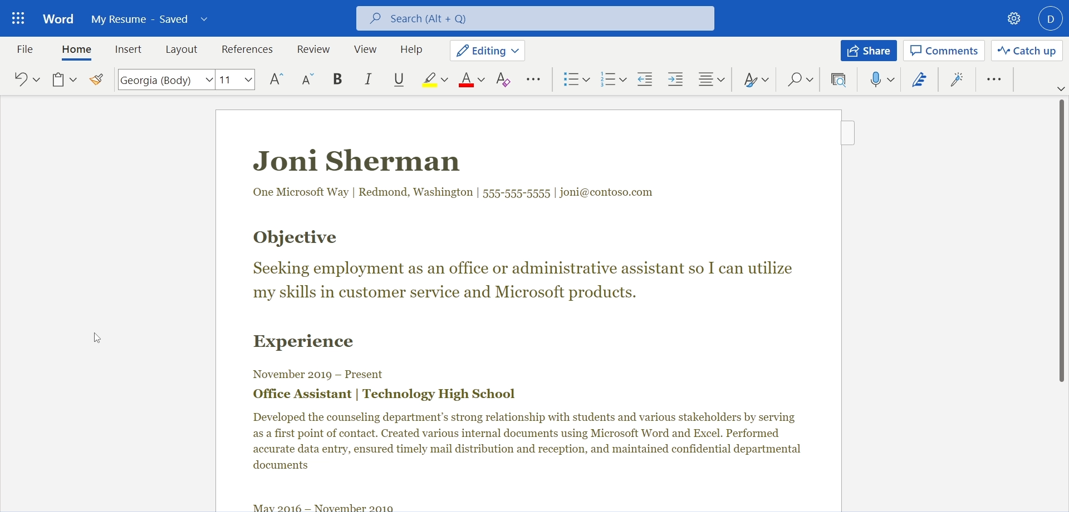
Exercise Files > My Resume 1.docx

Slide 12
Elevate Your Documents
Apply new styles
Adjust your text

Slide 13
Changing Margins

Slide 14
In this lesson:
Adjusting margins

Slide 15
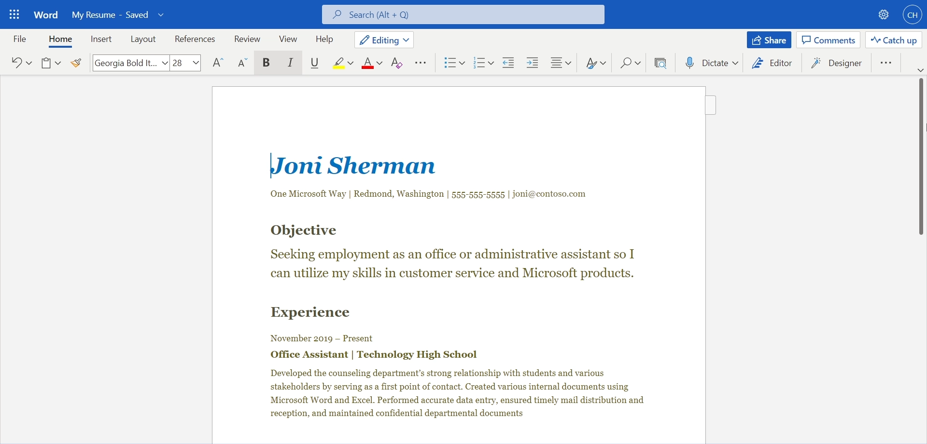
Exercise Files > My Resume 2.docx

Slide 16
Reshape your document
Apply margins in a document
Review the content change

Slide 17
Creating a PDF

Slide 18
Portable Document Format (PDF)
A computer file format for the transmission of a multimedia document that is not intended to be edited further and appears unaltered in most computer environments

Slide 19
In this lesson:
Printing Word documents digitally

Slide 20
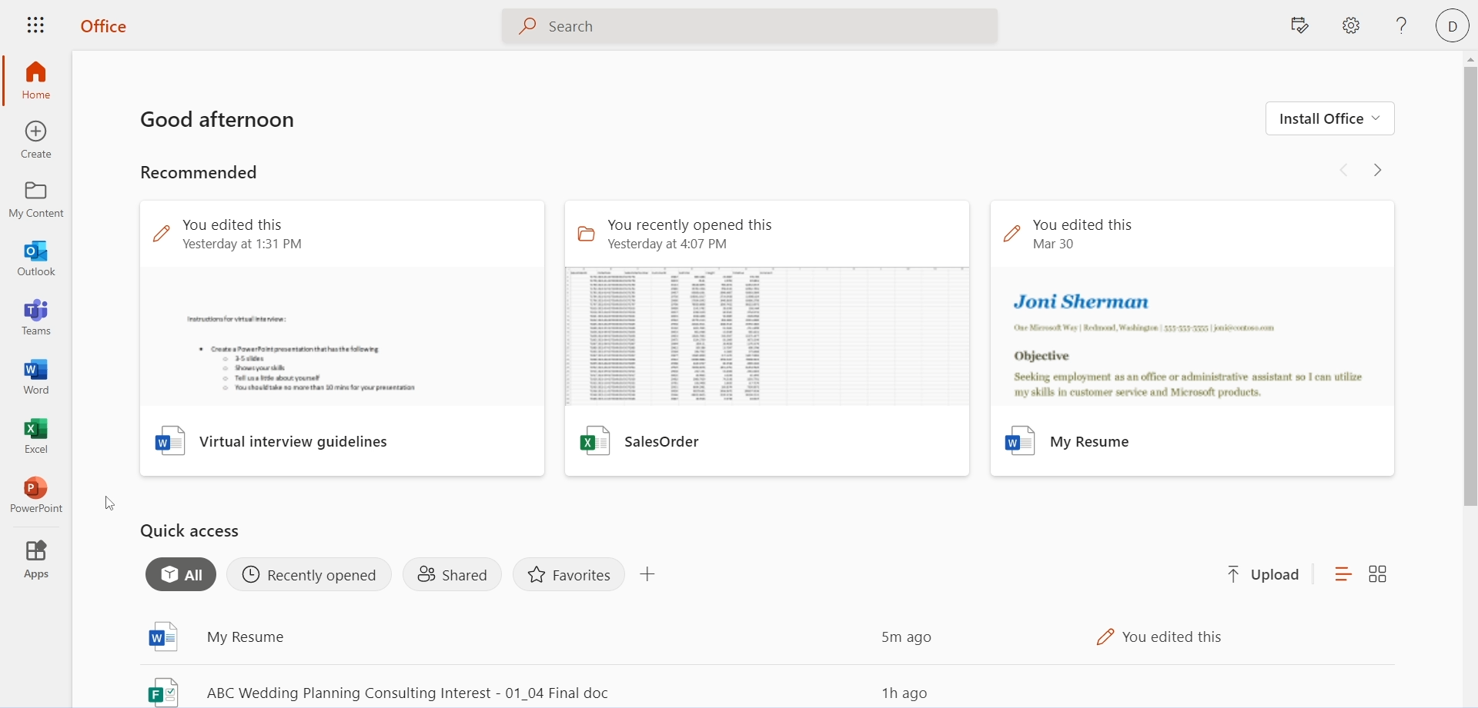
Exercise Files > My Resume 3.docx

Slide 21
Creating a PDF
Finalize your document
Save as PDF

Slide 22
Printing Documents

Slide 23
In this lesson:
Printing Word documents

Slide 24
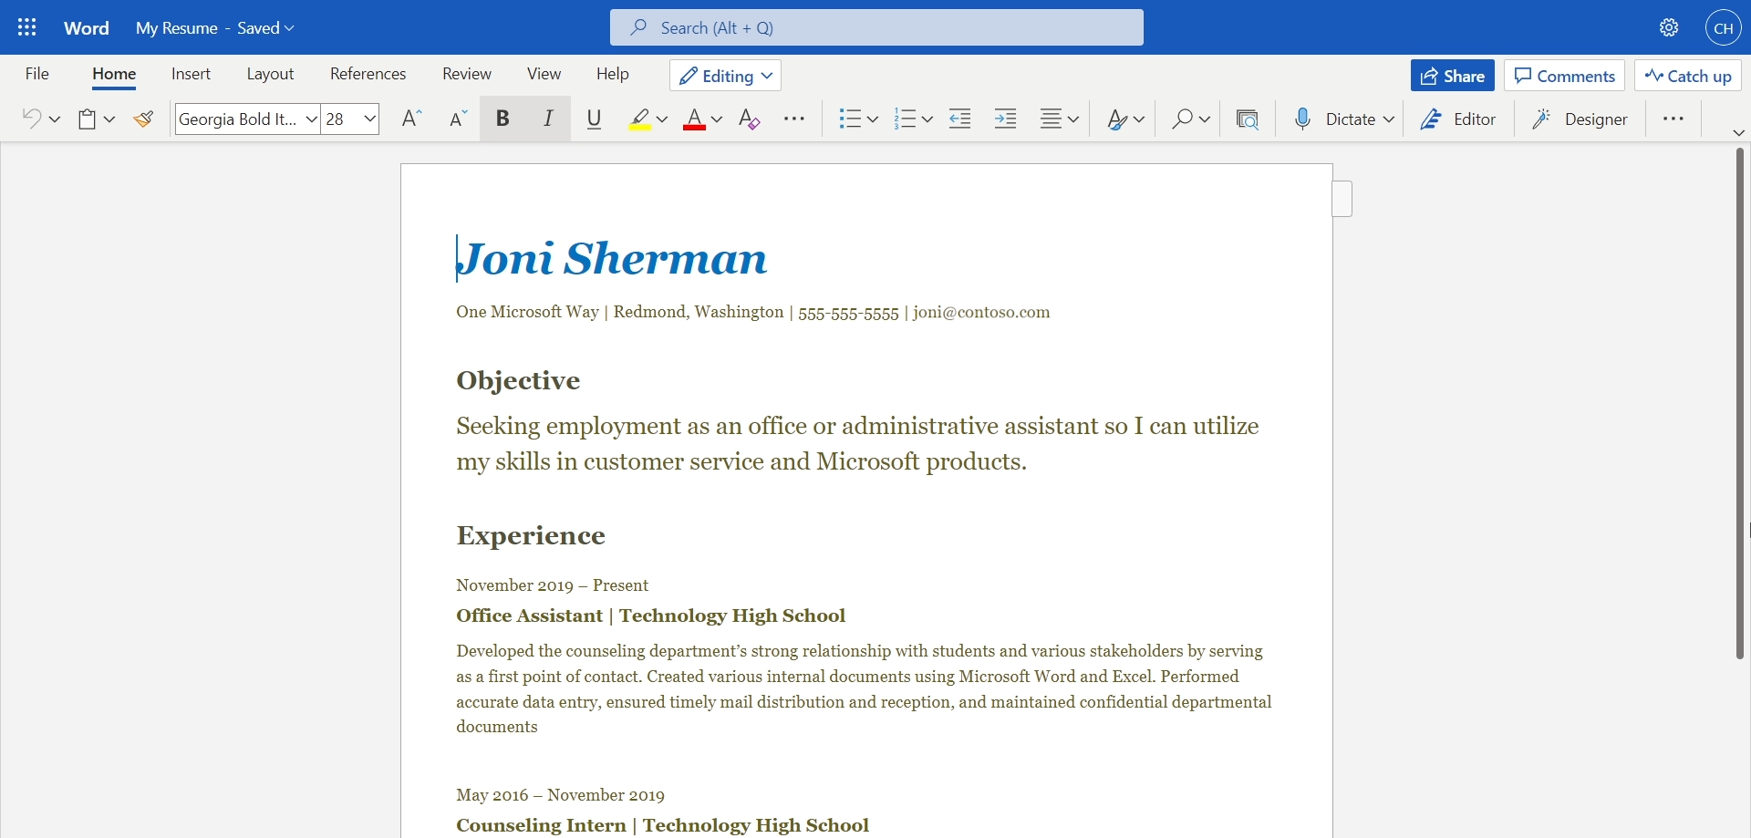
Exercise Files > My Resume 3.docx

Slide 25
Set Your Printer Destination

Slide 26
Print Your Resume
Finalize your document
Select your printer
Confirm settings
Print

Slide 27
Creating and Formatting Tables

Slide 28
In this lesson:
Creating tables in Excel

Slide 29
Excel Workbook
A file that contains one or more worksheets to help you organize data

Slide 30
Create a new table
Create a new Worksheet
Input your data

Slide 31
Using the SUM Function

Slide 32
In this lesson:
Calculating totals

Slide 33
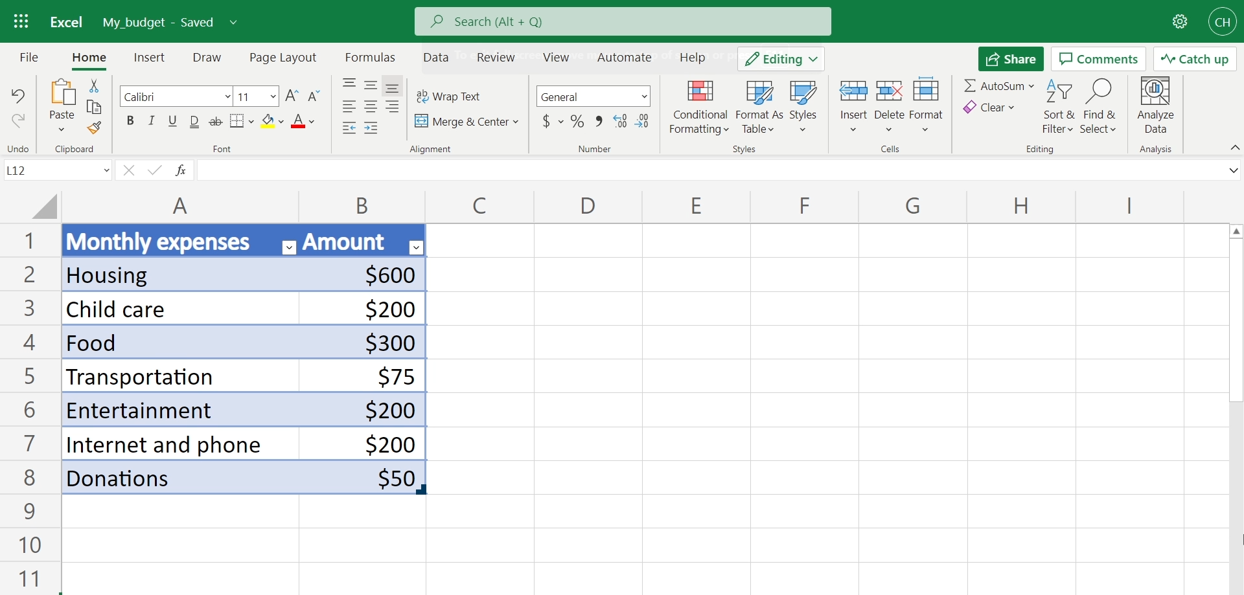
Exercise Files > My Budget 1.xlsx

Slide 34
The SUM Function
Use = SUM to sum a series of numbers and/or cells

Slide 35
Add up the total
Input numerical data
Use SUM to calculate totals

Slide 36
Sorting Data in a Table

Slide 37
In this lesson:
Sorting data

Slide 38
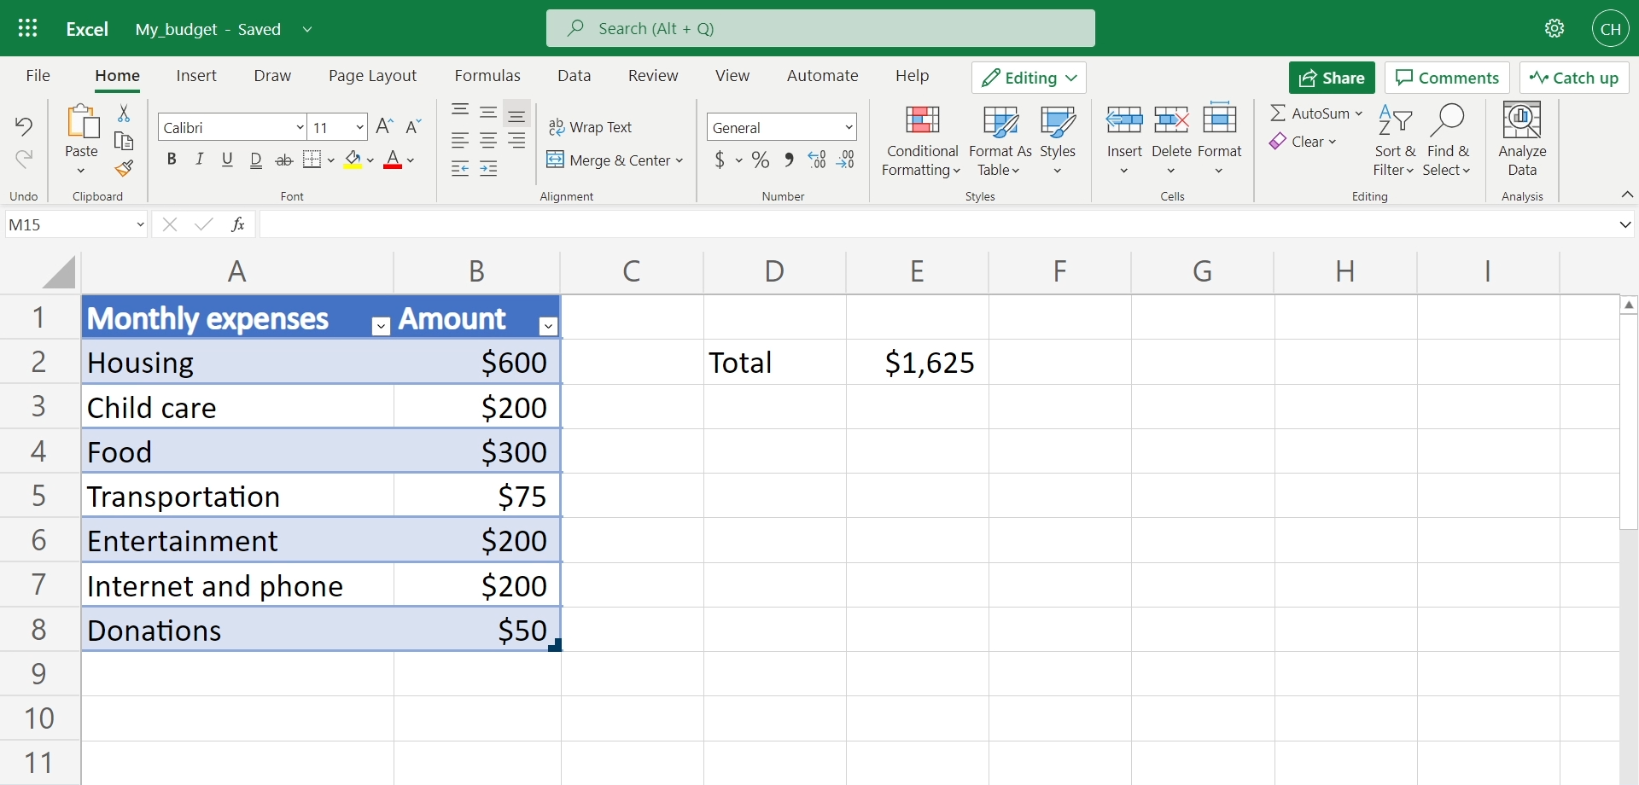
Exercise Files > My Budget 2.xlsx

Slide 39
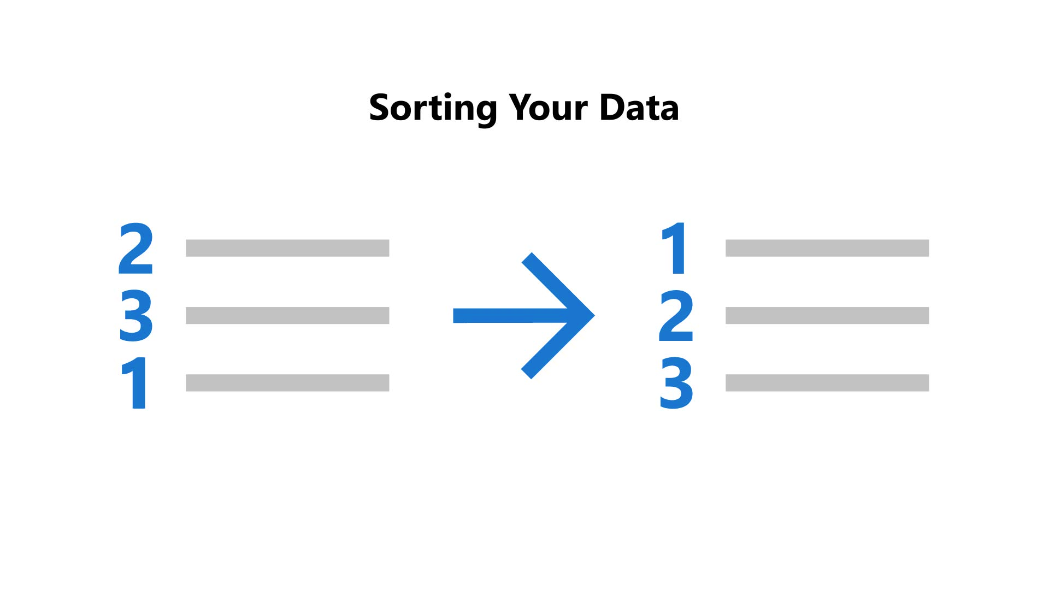
Sorting Your Data

Slide 40
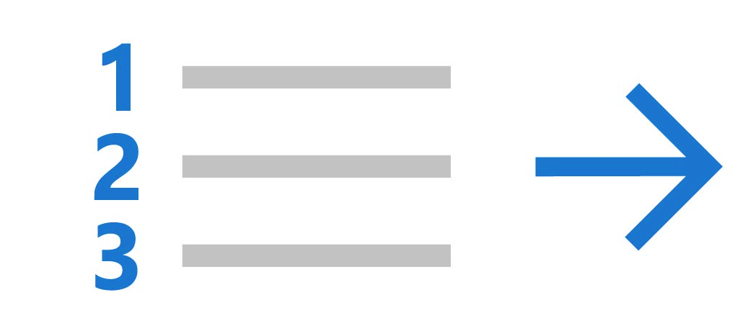
Filtering Your Data

Slide 41
Track your ata
Input data into a worksheet
Format data as a table
Sort data in a table

Slide 42
Displaying Data in Charts

Slide 43
In this lesson:
Using Excel to visualize data

Slide 44
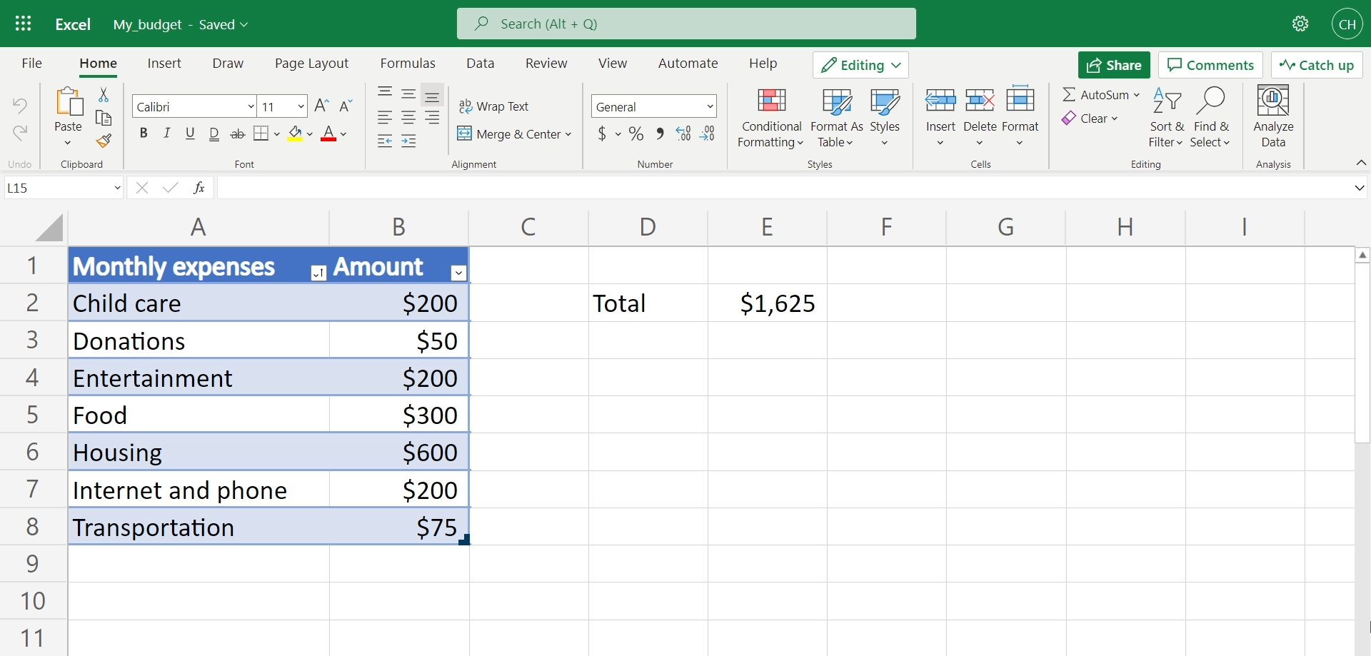
Exercise Files > My Budget 3.xlsx

Slide 45
Experiment with Charts
Select your data
Insert Recommended Charts
Test out alternative charts

Slide 46
Managing Your Worksheets

Slide 47
In this lesson:
Worksheet management

Slide 48
Build your workbooks
Copy content from one worksheet
Create a new worksheet
Move content to new worksheet

Slide 49
Managing and Editing Data

Slide 50
In this lesson:
Keeping data up-to-date

Slide 51

Exercise Files > My Budget 5.xlsx

Slide 52
Adjust your worksheet
Add and remove columns
Add and remove content
Add and remove rows
Merge cells

Slide 53
Creating a Notebook

Slide 54
In this lesson:
Organizing a notebook in OneNote

Slide 55
Creating A job search notebook

Slide 56
Build an organized notebook
Create and name a notebook
Add and name a section
Add and name a page

Slide 57
Creating and Duplicating Pages

Slide 58
In this lesson:
Creating pages and using templates in OneNote

Slide 59
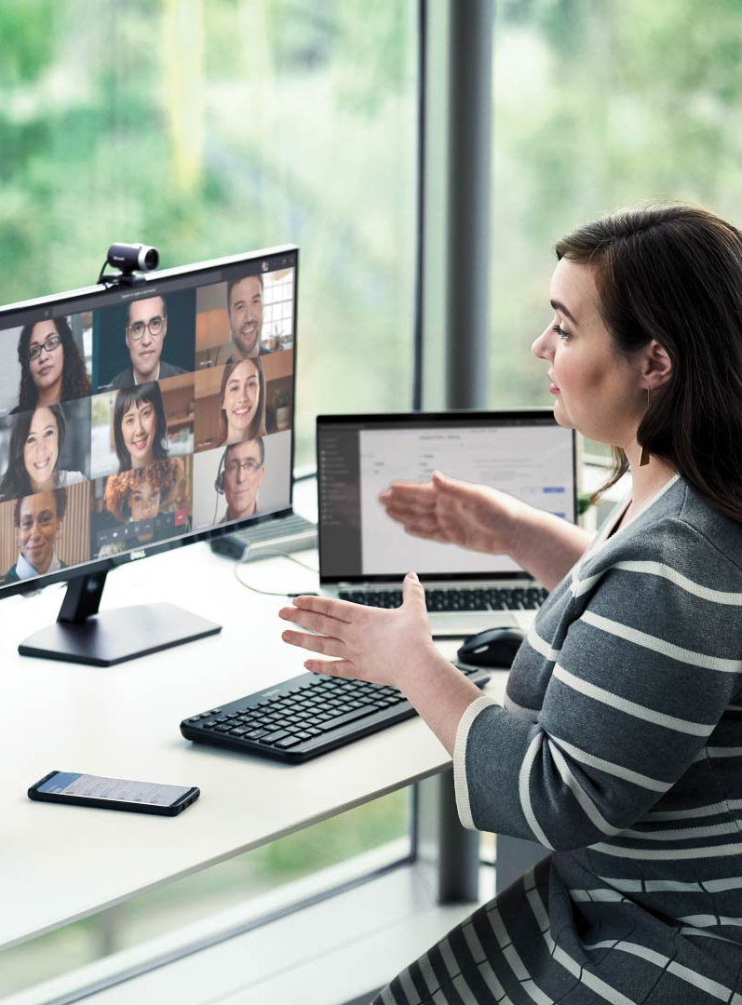
OneNote
Notebooks
Sections
Pages

Slide 60
Add pages to notebooks
Create custom templates
Create pages in your notebooks

Slide 61
Adding Links

Slide 62
In this lesson:
Adding links to a notebook

Slide 63
Hyperlink your notebook
Add hyperlinks to pages

Slide 64
Creating an Email Signature

Slide 65
In this lesson:
Creating an email signature

Slide 66
Improve your sign-off
Create a new email signature
Add your preferred text

Slide 67
Sending Attachments

Slide 68
In this lesson:
Sending attachments

Slide 69
Create email attachments
Open an email
Locate a document
Attach a document to an email

Slide 70
Searching and Filtering Email

Slide 71
In this lesson:
Searching and filtering your emails

Slide 72
Navigate your inbox
Search to locate an email
Filter to narrow your search

Slide 73
Creating a Presentation

Slide 74
In this lesson:
Adding slides to a presentation

Slide 75
Build out your presentation
Draft a presentation
Create a title slide

Slide 76
Using design Ideas

Slide 77

In this lesson:
Using Designer for presentations

Slide 78
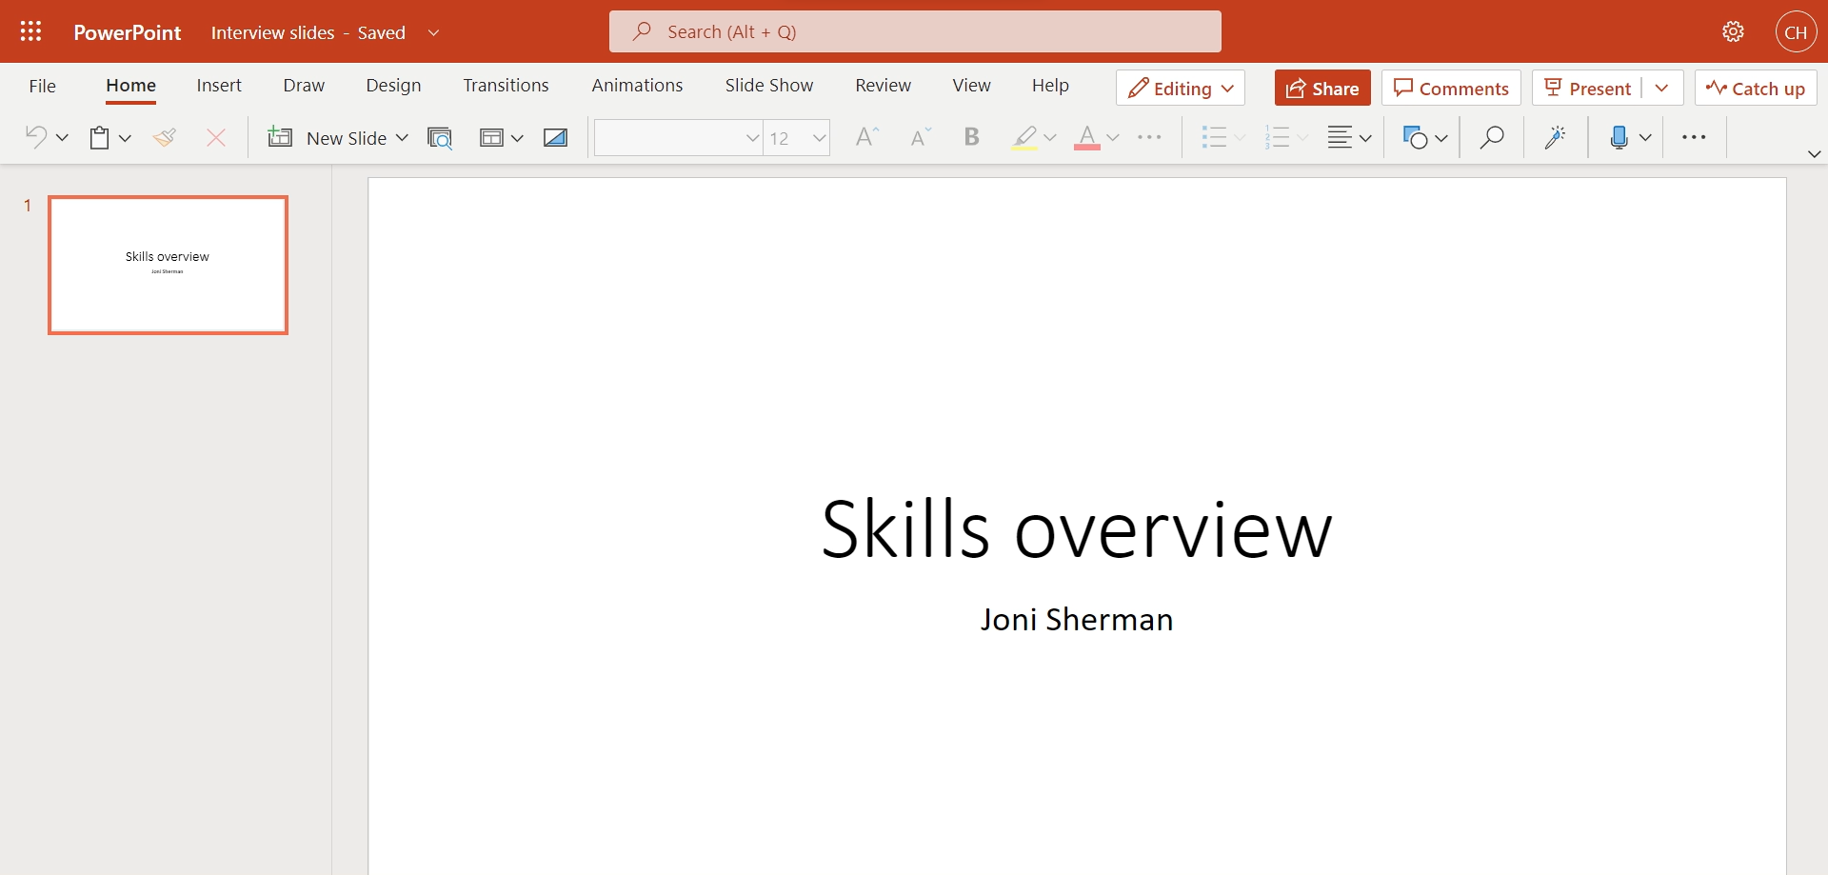
Exercise Files > Interview Slides 1.pptx

Slide 79
Take advantage of design
Design an engaging presentation
Give a presentation a new look

Slide 80
Applying Layouts and Reordering Slides

Slide 81
In this lesson:
Applying layouts and reordering slides

Slide 82
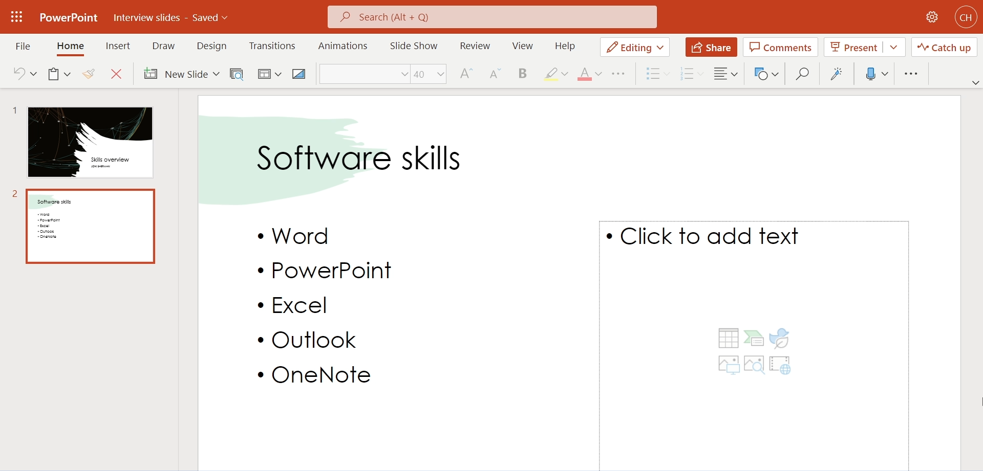
Exercise Files > Interview Slides 2.pptx

Slide 83
Adjust your presentation
Apply a slide layout
Reorder the slides

Slide 84
Adding and Formatting Text

Slide 85

In this lesson:
Updating text in presentations

Slide 86
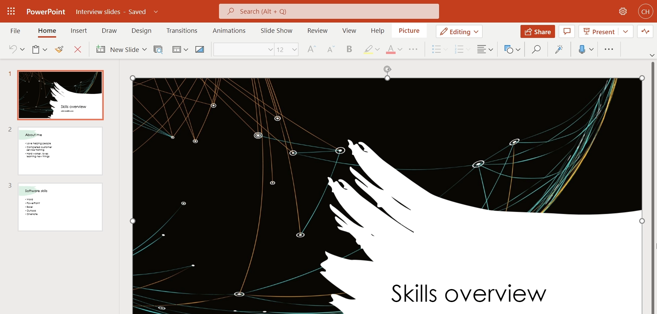
Exercise Files > Interview Slides 3.pptx

Slide 87
Format your presentation
Change font color
Change font style

Slide 88
Adding and Editing Pictures

Slide 89
In this lesson:
Adding and editing pictures in a presentation

Slide 90
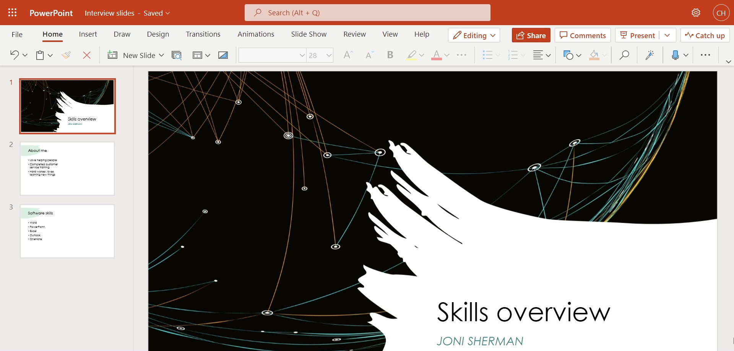
Exercise Files > Interview Slides 4.pptx

Slide 91
Present with visuals
Add photos, videos, and icons
Select slide layout
Change media size and location

Slide 92
Getting Started with Microsoft 365

Slide 93
In this course
Word
Excel
OneNote
Outlook
PowerPoint

Slide 94
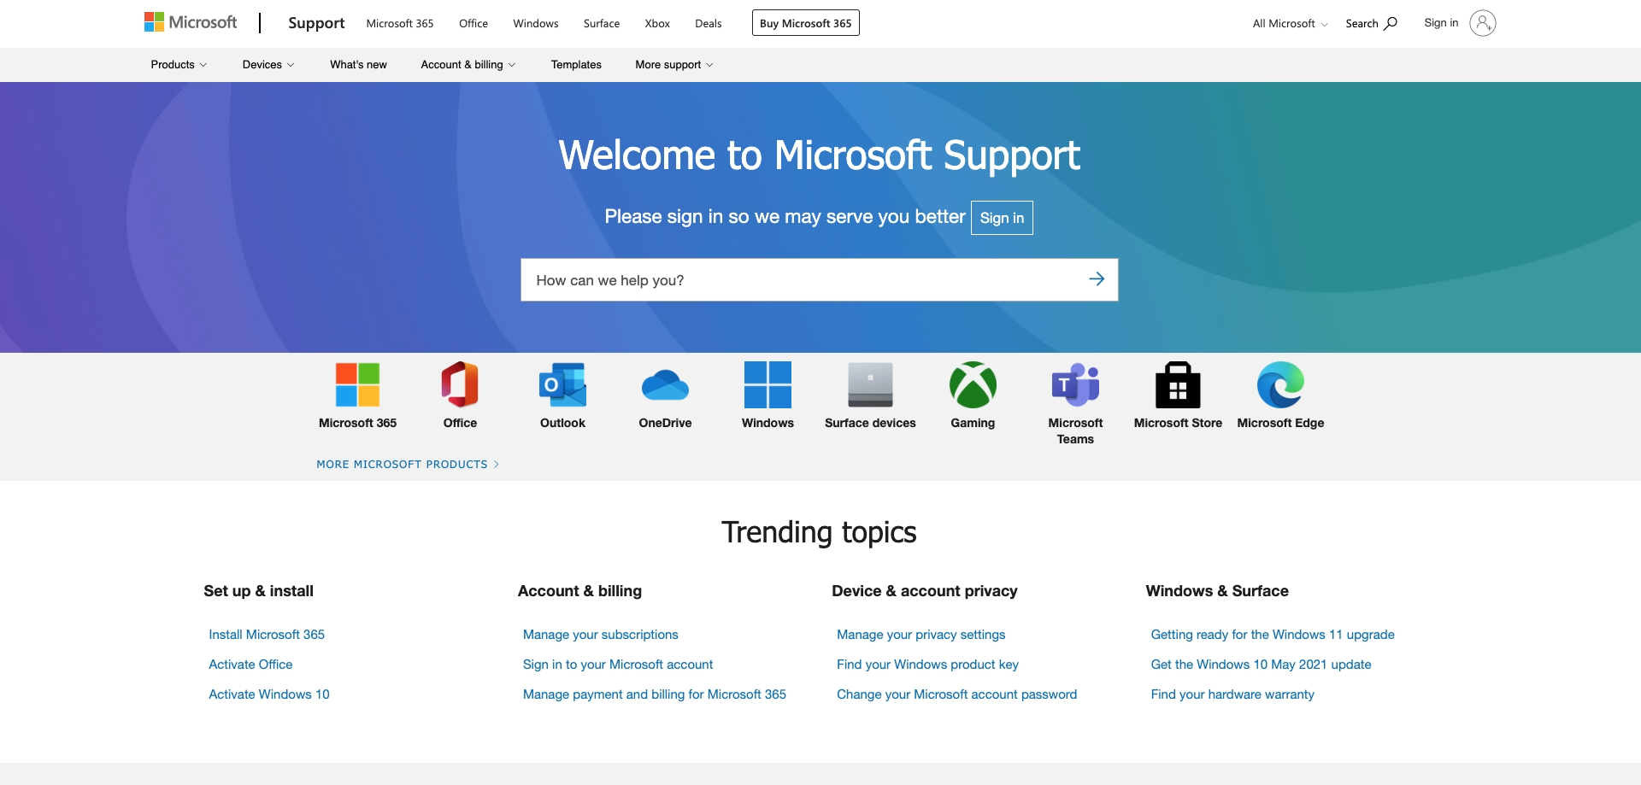
https://support.microsoft.com/

Slide 95
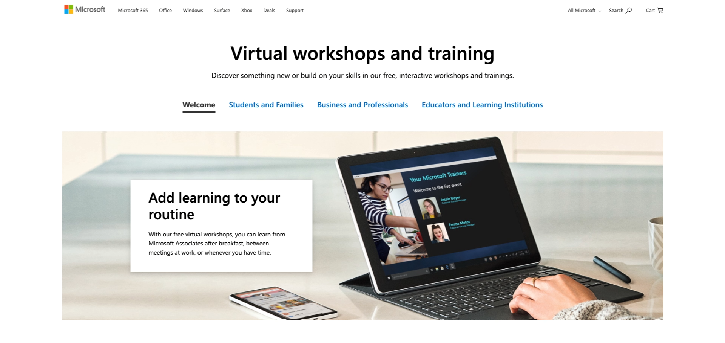
https://www.microsoft.com/en-us/store/workshops-training-and-events

Slide 96
Getting Started with Microsoft 365

